Slide 1


ECON 101
MIDTERM REVIEW SESSION
by Rachel Kim

Slide 2

Table of Contents
Introduction to Economics
The Economic Problem, PPF & Trade
Supply & Demand
Elasticity
Efficiency & Equity
Practice Questions
facebook.com/ubccmp
twitter.com/ubccmp
@ubccmp
cmp.cus.ca

Slide 3
1. Introduction to Economics
What is Economics?
Economics: the social science that studies the choices that individuals, businesses, governments, and entire societies as they cope with scarcity
Microeconomics: the study of choices that individuals and businesses make, the way those choices interact in markets, and the influence of government.
Economic Way of Thinking
Economic questions arise due to human’s infinite desires and scarce resources. Due to scarcity, we must make choices, depending on the incentives we face
Every choice is a trade-off; give up one to get another
Optimal choices for:
Individuals- satisfy personal desires
Firms- maximize profit
Government- maximize social welfare
facebook.com/ubccmp
twitter.com/ubccmp
@ubccmp
cmp.cus.ca

Slide 4
1. Introduction to Economics
Economic Questions
How do choices end up in determining: what to produce, how much to produce, and for whom to produce?
When do choices made in pursuit of self-interest also promote the social interest?
Economic Reasoning: measure everything by cost and benefit
If Marginal Benefit>Marginal Cost, do it!
If Marginal Benefit < Marginal Cost, don’t do it!
facebook.com/ubccmp
twitter.com/ubccmp
@ubccmp
cmp.cus.ca

Slide 5
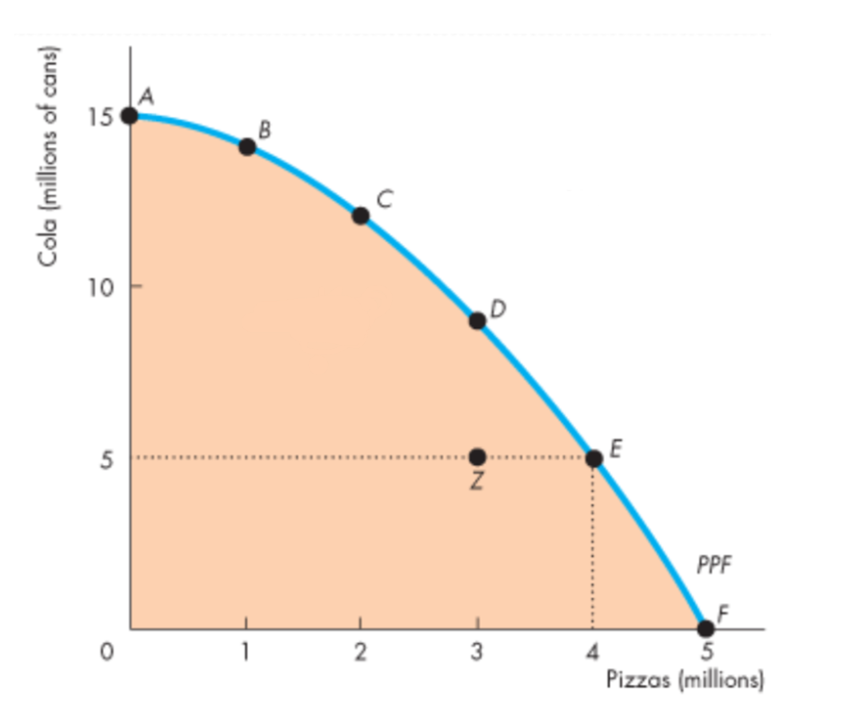
2. The Economic Problem & PPF
Opportunity Cost (OC): the cost of second-best alternative; the benefit forgone by undertaking that activity
OC of good x= (△qty. y)/ (△qty. x)
Production Possibilities Frontier (PPF): represents the boundary between the combinations of goods/services that can be produced and that cannot.
Q1: Label product efficiency on each area of PPF:
facebook.com/ubccmp
twitter.com/ubccmp
@ubccmp
cmp.cus.ca

Slide 6
2. The Economic Problem & PPF
Q2: What is the effect of technological improvements for the PPF of a country? How can that induce economic growth?
Q3: Given the following production combinations for pizza and burger, what is the opportunity cost of producing additional units of pizza? (1 min)
Pizza | Burger
0 | 10
1 | 9
2 | 7
3 | 4
facebook.com/ubccmp
twitter.com/ubccmp
@ubccmp
cmp.cus.ca

Slide 7
2. The Economic Problem & PPF
Marginal Cost, Marginal Benefit & Allocative Efficiency
Marginal cost: additional cost incurred from one more unit
Marginal benefit: additional benefit from one more unit
Allocative efficiency: when we cannot produce one more of any good that provides greater benefit
where MB=MC
facebook.com/ubccmp
twitter.com/ubccmp
@ubccmp
cmp.cus.ca

Slide 8
2-1. Economic Coordination & Trade
Absolute Advantage: more productive than others
produce more in same time/material
produce same quantity with less time/material
Comparative Advantage: perform an activity at a lower opportunity cost
supplier with comparative advantage should specialize in that area
Trading condition: Seller’s OC<= price of good <= buyer’s OC
Gains from trade= (qty. after trade)- (qty. before trade)
facebook.com/ubccmp
twitter.com/ubccmp
@ubccmp
cmp.cus.ca

Slide 9
2-1. Economic Coordination & Trade
Q4: Assume James and Anna both produce smoothies and salad. James can produce 6 smoothies and 30 salads per hour. Anna can produce 30 smoothies and 30 salads per hour.
Who has an absolute advantage in smoothie production? In salad production?
Who has a comparative advantage in smoothie production? In salad production?
What should James and Anna specialize in?
What is the quantity range of trading smoothie? Of trading salad?
If Anna sells 10 smoothies for 20 salads, how does James benefit? How does Anna benefit?
facebook.com/ubccmp
twitter.com/ubccmp
@ubccmp
cmp.cus.ca

Slide 10
3. Supply and Demand
Demand
Quantity Demanded: amount of goods/services that consumers plan to buy during a specific time and place
Law of Demand: Ceteris Paribus, the higher the price of the good, the smaller quantity demanded
Demand: the entire relationship between the price of goods and quantity demanded
Shift factors:
Price of related goods
Expected future prices
Income
Expected future income
population
personal preference
facebook.com/ubccmp
twitter.com/ubccmp
@ubccmp
cmp.cus.ca

Slide 11
3. Supply and Demand
Supply
Quantity Supplied: amount of goods/services that producers plan to sell during a given time period at a particular price
Law of Supply: Ceteris paribus, the higher the price of the good, the greater quantity supplied
Supply: the entire relationship between the price of good and quantity supplied
Shift factors:
price of factors of production
price of related goods produced
expected future prices
technology
state of nature
facebook.com/ubccmp
twitter.com/ubccmp
@ubccmp
cmp.cus.ca

Slide 12
3. Supply and Demand
Equilibrium
Equilibrium price: the price at which the quantity demanded equals quantity supplied
Equilibrium quantity: the quantity bought and sold at the equilibrium price
Q5: Predict changes in Eq and Ep for given scenarios
Increase in demand
Decrease in demand
Increase in supply
Decrease in supply
Increase in Supply & Demand
Decrease in Supply & Demand
Increase in Supply & Decrease in Demand
Decrease in Supply & Increase in Demand
facebook.com/ubccmp
twitter.com/ubccmp
@ubccmp
cmp.cus.ca

Slide 13
3. Supply and Demand
Q6: Assume that potato chips and Oreos are substitutes, and they require the same production resources. If the demand for potato chips suddenly rises, what happens to the market of potato chips and Oreos? Explain using the Supply and Demand curve action.
Q7: If polyester is an inferior good, and household income goes up, what happens in the supply and demand graph for polyester?
facebook.com/ubccmp
twitter.com/ubccmp
@ubccmp
cmp.cus.ca

Slide 14
4. Elasticity
Price Elasticity of Demand
Responsiveness of QD of a good to a change in its price
(% change in QD)/(% change in price)
Influence factors
closeness of substitutes
proportion of income spent on the good
time elapsed since price change
Price Elasticity of Supply
Responsiveness of QS of a good to change in its price
(% change in QS)/(% change in price)
Influence factors
resource substitution possibilities
time frame for supply decision
facebook.com/ubccmp
twitter.com/ubccmp
@ubccmp
cmp.cus.ca

Slide 15
4. Elasticity
Elasticity | Calculation | Explanation | Examples
Perfectly Elastic | Ed=undefined | When price of a good doesn't change despite the QD | Highly situational/hypothetical
Elastic | Ed>1 | If % change in QD is greater than % change in P | Luxury goods
Unit Elastic | Ed=1 | If % change in QD equals % change in P | situational
Inelastic | Ed<1 | If % change in P is greater than % change in QD | Necessities
Perfectly Inelastic | Ed=0 | If QD demand doesn't change despite the P | Highly situational/hypothetical
facebook.com/ubccmp
twitter.com/ubccmp
@ubccmp
cmp.cus.ca

Slide 16
4. Elasticity
Elasticity and Total Revenue
TR= (price)*(quantity)
Elasticity | When price increases
elastic demand | TR decreases
inelastic demand | TR increases
unit elastic demand | TR does not change
facebook.com/ubccmp
twitter.com/ubccmp
@ubccmp
cmp.cus.ca

Slide 17
4. Elasticity
Cross Price Elasticity
Responsiveness of QD of a good to a change in the price of a complementary/substitute good
(% change in QD)/(% change in price of complement/substitute)
positive→ substitutes
negative → compliments
zero→ unrelated goods
Income Price Elasticity
Responsiveness of QD to a change in consumer’s income
(% change in QD)/(% change in income)
>1 → normal good; income elastic
0<income elasticity<1 → normal good, income inelastic
<0 → inferior good
facebook.com/ubccmp
twitter.com/ubccmp
@ubccmp
cmp.cus.ca

Slide 18
5. Efficiency & Equity
Consumer Surplus
excess benefit received from a good over the amount paid for it
Ex) When a buyer is willing to pay $10 for a good, but the market price is only $5
= Area under the demand curve & above price paid
Producer Surplus
excess of the amount received from the sale of a good over the cost of producing it
Ex) When a seller receives $20 for a good worth $5
=area under the market price $ over the supply curve
Market Efficiency
o Efficiency met at QD=QS, at market equilibrium
o Consumer surplus is maximized.
o Producer Surplus is maximized.
facebook.com/ubccmp
twitter.com/ubccmp
@ubccmp
cmp.cus.ca

Slide 19
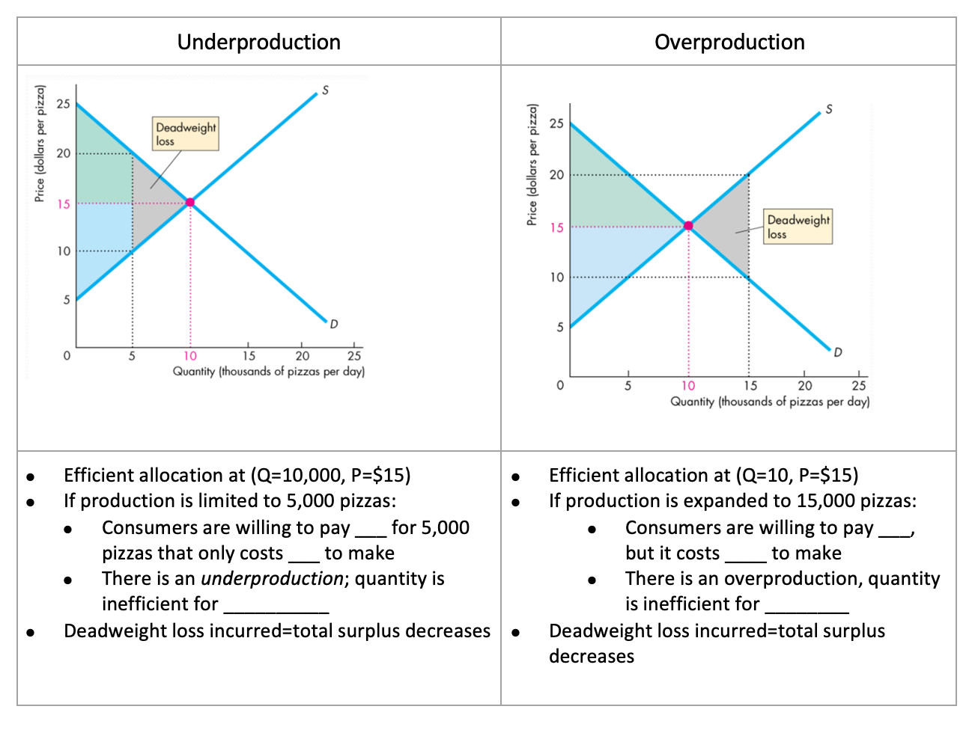
5. Efficiency & Equity
· Market Inefficiency
facebook.com/ubccmp
twitter.com/ubccmp
@ubccmp
cmp.cus.ca

Slide 20
Questions?

Slide 21
More Practice!
Which of the following is NOT an example of a microeconomic topic?
the effect of a flood in BC on the price of bottled water
Wages of cross-country truckers
How the unemployment and inflation rates are related
the effect of a frost on the Florida orange price
Charles is planning to either: play basketball, watch TV, or eat pizza. The opportunity cost of eating pizza:
is the value of playing basketball, if Charles prefers that over watching TV.
depends how much the pizza costs
depends on how much Charles loves pizza
the value of watching TV if Charles prefers playing basketball over watching TV
If Marc is producing at a point inside his production possibilities frontier, then he:
has a high opportunity cost of moving from this point
can increase production of both goods with zero opportunity cost
is fully using all his resources and allocating his resources efficiently
has unlimited resources
Which situation is the best example of the Law of Demand?
When the price of books increases, consumers buy fewer books.
When the wages of auto workers rise, automakers raise the price of cars.
When the price of computers fall, demand for computer games increases.
When consumer incomes rise, consumers buy more televisions.
facebook.com/ubccmp
twitter.com/ubccmp
@ubccmp
cmp.cus.ca

Slide 22
More Practice!
5. If demand for product X decreases when the price of product Y decreases, then X and Y are:
not related
both inferior foods
complements
substitutes
6. When ducks are slaughtered for meat, their feathers can be used in the production of pillows. Given this relationship, if the demand for duck meat rises,
the price of feather pillow falls
supply of feather pillow falls
demand for feather pillow rises
the price of duck meat falls
7. For which of the following products is the consumer’s demand curve most likely to be vertical?
lobster, for a seafood lover
cars, for high school students
insulin, for a diabetic
beef, for a food lover
8. The more broadly a good is defined,
the fewer substitutes it has so the less elastic is its demand
the more substitutes it has so the more elastic is its demand
the fewer substitutes it has so the more elastic is its demand
the more complements it has so the more elastic is its demand
facebook.com/ubccmp
twitter.com/ubccmp
@ubccmp
cmp.cus.ca

Slide 23
More Practice!
9. The cross-price elasticity of demand between rifles and bullets is likely to be
negative because the goods are substitutes
positive because the goods are substitutes
0 because the goods are not substitutes
negative because the goods are complements
10. ( ) have income elasticities that are ( ).
normal goods, negative
luxuries, less than one
necessities, greater than 1
inferior goods, negative
11. If a firm raises the price of its product, its total revenue will
always increase
never increase
increase only if demand is price inelastic
increase only if demand is price elastic
12. When the price of a good increased by 10%, the quantity demanded decreased by 5%. The price elasticity of demand is ( )%, anda price rise will () TR.
0.5, increase
-2.0, decrease
0.5, decrease
2, increase
facebook.com/ubccmp
twitter.com/ubccmp
@ubccmp
cmp.cus.ca

Slide 24
More Practice!
13. In one hour, Daniel can produce 40 socks or 8 shoes; Vivian can produce 80 socks or 10 shoes.
Draw PPF for Daniel and Vivian, showing the production point (A) for each PPF when each spends 30 min of an hour producing socks and 30 min producing shoes.
Who should specialize in what production? Show the specialized production point B on the PPF.
After specialization, there are two options for trade:
4 shoes for 24 socks
4 shoes for 16 socks
Which option will be acceptable to both for trade?
facebook.com/ubccmp
twitter.com/ubccmp
@ubccmp
cmp.cus.ca

Slide 25
More Practice!
14. For each scenario, draw the shift of supply or demand curve and explain the effect on Ep and Eq for Supply & Demand curve for Lululemon pants:
A fire in India destroys the latest shipment of Lululemon goods.
The new movie, ‘Yoga Mamas’ is a huge hit, and yoga wear popularity rises.
Lululemon slashed its prices on all products by 50%.
facebook.com/ubccmp
twitter.com/ubccmp
@ubccmp
cmp.cus.ca

Slide 26
More Practice!
15. The price of Canucks tickets drops from $120 to $100 a game. The quantity of tickets sold falls from 160,000 tickets to 144,000.
Calculate the price elasticity of demand for gasoline.
As the price falls, by what % should the demand have risen for the TR to be maximum?
By what % should the demand have risen for the demand to be perfectly inelastic?
facebook.com/ubccmp
twitter.com/ubccmp
@ubccmp
cmp.cus.ca

